Slide 1
Application of Liquid Crystals
Student: Robert Ng U6CHR
Assessor: Mr Clark

Slide 2
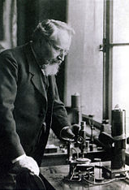
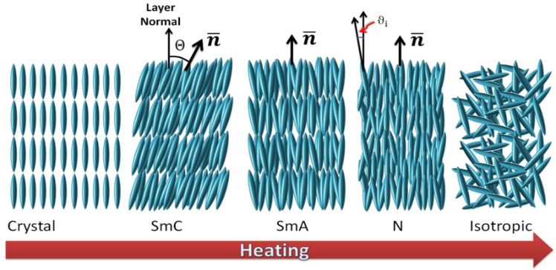
History
First discovered 1888
Friedrich Reinitzer
Otto Lehmann
Double melting phenomenon

Slide 3
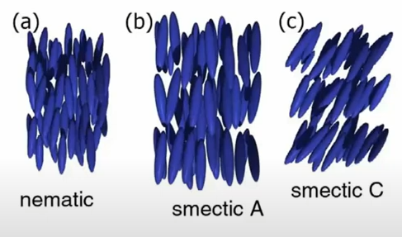
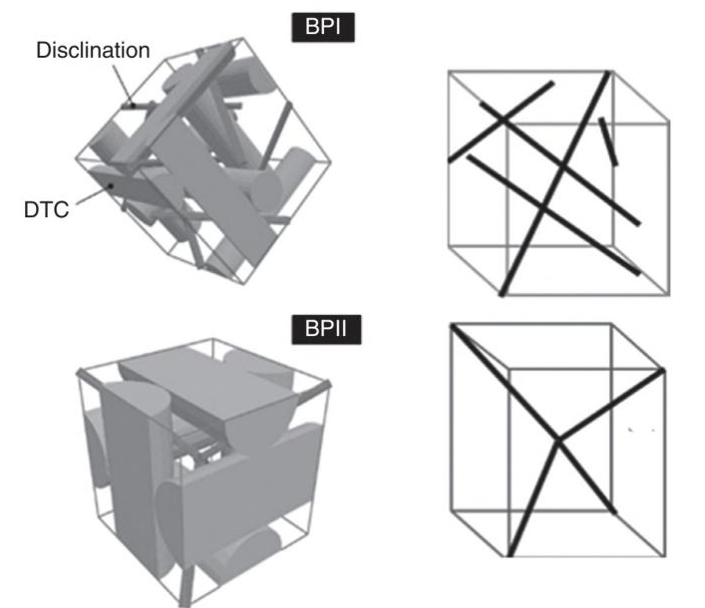
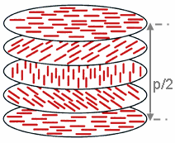
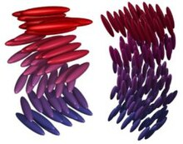
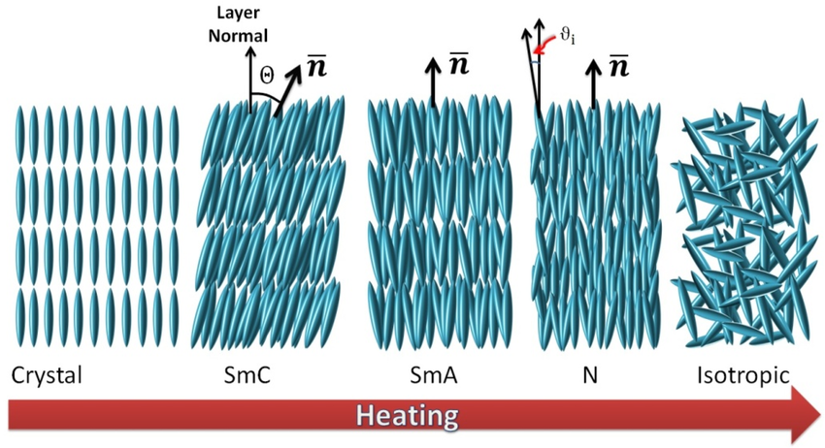
Thermotropic Liquid Crystals
Nematic
Smectic
Twisted nematic
Blue phase

Slide 4
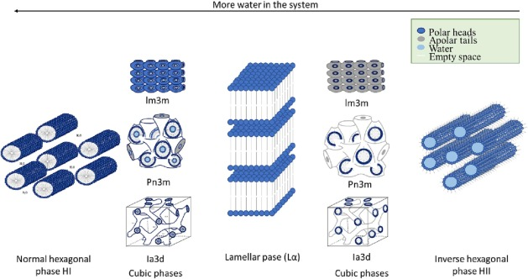
Lyotropic Liquid Crystals
Micellar cubic phase
Hexagonal (columnar) phase
Lamellar phase
Hexagonal (columnar) phase
Inverse micellar phase

Slide 5
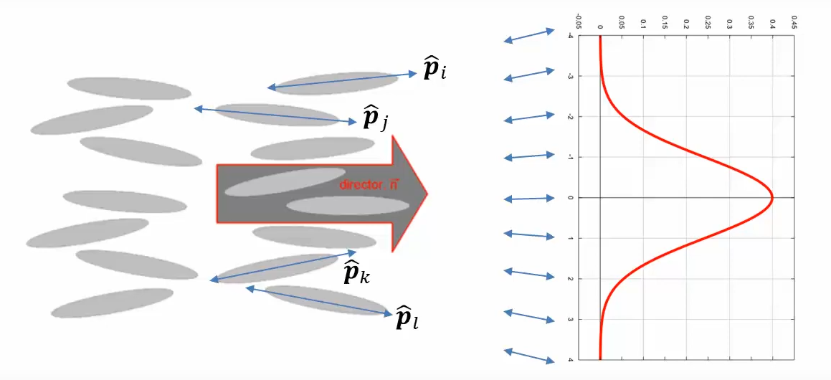
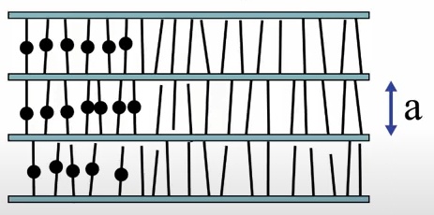

Order Parameters
Orientational order parameter
$S=\frac{1}{2}<3\cos^{2}{θ−1}>$
Translational order parameter
$S=<\cos\left(\frac{2πz}{a}\right)>$
Bond orientational parameter
Chiral order
Polarisation order

Slide 6
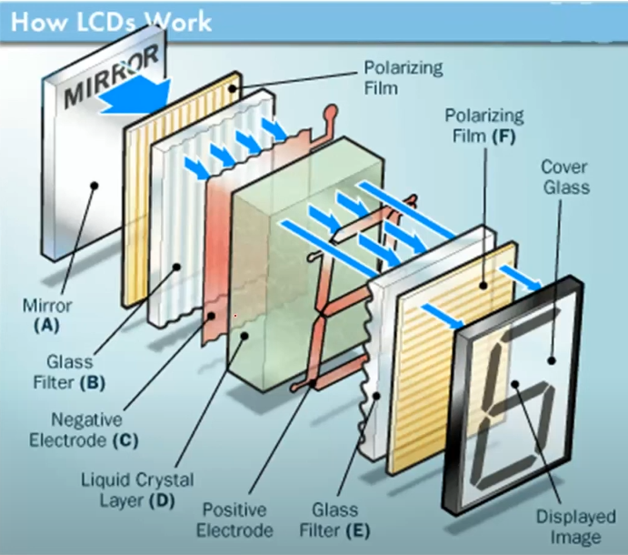
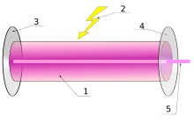
Applications
Quantum technology
LCDs
Smart Glass
Liquid crystal thermometers
Laser emission
Liquid crystal cored fiber array
Stealth tech
Notes:
An alternative to using these fibers in the fiber array are waveguides. Waveguides work with the same principle of a core and cladding followed by total internal reflection. However, compared to fibers which are strictly cylindrically shaped, waveguides can have various shapes such as a planar rectangular structure. They often flat and confined into a substrate.

Slide 7
THANK YOU FOR LISTENING!

